Slide 1


Exploratory Data Analysis and Predictive Modeling for Marketing
Term-Deposit Scheme in Financial Services Industry

Slide 2


Today's agenda
Project Overview
The Analytics team
Objective
Data Dictionary
Process
Summary
Notes:
Today's agenda will be as follows:
1. We will recap the overall project to give a high level understanding of the business problem we're tackling and the specific requirements.
2. We will dive into the specific problem that we, the Data Analytics team, have been focusing on and will give some background as to why this is such a big problem.
3. After introducing the problem, I will go over the team responsible from our side in tackling this task.
4. I will then go over the high-level process that we followed to complete this task, so that you have complete clarity in how we tackle these kinds of tasks.
5. Finally, I will go over the all important results and I will present them as a series of insights and visualizations from our analysis.
To wrap up, I will summarize and open for any questions.

Slide 3

Domain: Marketing for Financial Services
S
Domain: Marketing for Financial Services
About DB Bank:
Public sector bank providing services (savings accounts, loans, etc.).
Recently launched a marketing campaign for term deposits.
Customers are contacted via phone; campaign success is measured by whether the client agrees to place a term deposit.
Project Overview
Notes:
To kick things off let me recap this engagement.
We, Accenture have embarked on a 3 month pilot with Social Buzz to focus on 3 main tasks, aligned with some of the biggest challenges that you're currently facing.
Social Buzz has reached huge scale in recent years to become recognized as a global unicorn company. We are here to help you manage this scale and to guide you in the right direction.
Firstly, we will be doing an audit of your big data practice and sharing best practices and industry expertise. Secondly we will be guiding you through a successful IPO, of which we have deep expertise and knowledge of within our team. And finally, we have conducted an analysis of your data to find insights regarding your top 5 most popular categories of content

Slide 4
Abhinash Gochhayat
2141007031
Ishita Jena
2141010031
Laxmidhar Sahu 2141019147
Swagat Choudhury 2141003034
Priyanshu Sahu 2141019168
Pratham Patnaik 2141016179
Anshuman Sahu 2141019157
Anubhav Dwivedy 2141004159
Priyanshu Prakash Singh 2141019357
The Analytics team
Notes:
Talking about experience, we have a large data analytics practice at Accenture but we had a team of 3 people primarily focusing on this task. Andrew Fleming is our Chief Technical Architect and his expertise really helped to guide the team to produce high quality analysis.
Marcus Rompton, a senior data expert has worked with the worlds biggest clients on solving their data problems and was heavily involved in the data engineering side of this project.
And finally myself, Gourav, who was solely responsible for taking leadership guidance and delivering high quality insights from the raw datasets and turning these into business decisions.

Slide 5
Data Exploration
Descriptive Analytics
Feature Engineering
Predictive Modelling
Model Evaluation
Insights and Recommendation
Objectives
Notes:
So, how did we tackle this problem?
Well, we approached it in 5 steps:
1. Data understanding - the key to success on any data project is to understand the data in detail. So we took the time to understand the data model and domain of your business.
2. Data extraction - after understanding your business, we then architected what an ideal dataset should look like for this problem and extracted it from the relevant data sources.
3. After extracting the raw data, we needed to process and model this data into a dataset that can precisely answer the business questions and produce analytics.
4. With our new dataset, we used our analytical expertise to uncover insights from this dataset and to produce visualizations to describe the insights.
5. And finally we used these insights to unlock business decisions and to make recommendations on next steps.

Slide 6


Data Dictionary
Bank Client Data
Campaign Data
Economic Data
Geographical Data
Response Data
Notes:
Focusing on the last point that I mentioned there, this is what the Data Analytics team has been specifically focused on.
Clearly with such grand scale, this comes with a lot of data and with such vast amounts of data comes challenges.
To give a background on how much data you've been creating:
- You told us that your platform receives over 100000 posts per day which amounts to 36 500 000 posts every year, of which, this is all unstructured data making it very hard to make sense of.
In this day and age, content is king. Just look at some of the biggest platforms in the world, for example YouTube, Facebook and Netflix... they are all content businesses...
But how to capitalize on it when there is so much?
It's not just all about harvesting as much content as possible... The real value is in understanding and crunching this content to gain a deeper understanding of your audience and to therefore provide a more personalized and enjoyable experience.
And this is where out data analytics expertise comes in, with the insights that we've uncovered from this task, we can show you exactly how to take analytics to production at scale.

Slide 7
Data Manipulation & Visualization
Tasks:
Load dataset, Merge datasets, clean data (handle missing values, outliers), and apply transformations.
Visualize the data using matplotlib & seaborn.
Steps:
Import dataset, perform data exploration, apply necessary transformations.
Create informative visualizations such as histograms, bar graphs, and box plots.
Notes:
From our analysis you can see that the top 5 most popular categories of posts were food, culture, soccer, cooking and animals in descending order.
Food had an aggregate popularity score of almost 1100. It is very interesting to see both food and cooking within the top 5, it really shows what people enjoy consuming as content. But also interesting to see culture too. Clearly users favor "real-life" content on this platform.
Furthermore soccer is an interesting category because there is the European championships being played very soon. This presents a huge opportunity for you to differentiate your platform and to run specific content or events linked to this global spectacle.

Slide 8
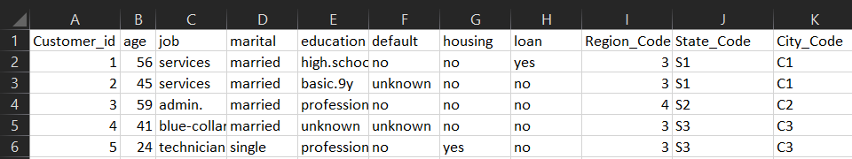
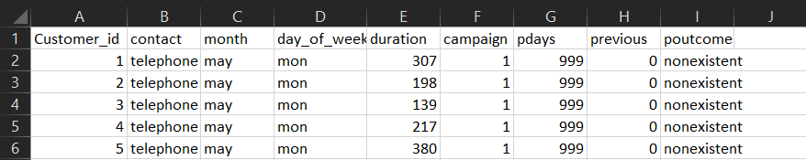
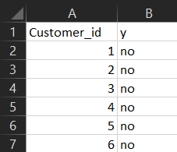
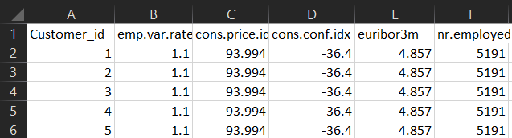
Given Dataset
Customer and bank details
Customer campaign details
Customer Response data
Customer social economic detail
Notes:
Additionally, you can see from this chart the % split of popularity between the top 5 categories. There is not much difference between each of them, food only outperforms culture by 0.4% within the top 5.
However the difference between the 4th most popular, cooking, and the 5th most popular, animals, is much larger at 1.3%
This tells me that the categories sorted by popularity is weighted towards categories at the top. This means that it exhibits a "greedy" effect, the most popular categories get more popular whilst as you drop down the popularity rankings, you may see that they fall away drastically.

Slide 9
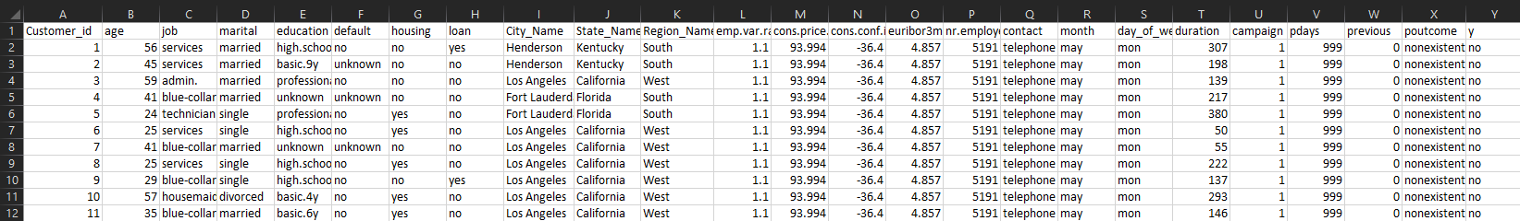
The Dataset created by merging the given datasets:
Notes:
Additionally, you can see from this chart the % split of popularity between the top 5 categories. There is not much difference between each of them, food only outperforms culture by 0.4% within the top 5.
However the difference between the 4th most popular, cooking, and the 5th most popular, animals, is much larger at 1.3%
This tells me that the categories sorted by popularity is weighted towards categories at the top. This means that it exhibits a "greedy" effect, the most popular categories get more popular whilst as you drop down the popularity rankings, you may see that they fall away drastically.

Slide 10
Exploratory Data Analysis (EDA)
Techniques:
Univariate, bivariate analysis.
Identify key trends affecting campaign success, such as customer demographics and economic factors.
Deliverables:
Python code, data summary, and visualizations.
Notes:
From our analysis you can see that the top 5 most popular categories of posts were food, culture, soccer, cooking and animals in descending order.
Food had an aggregate popularity score of almost 1100. It is very interesting to see both food and cooking within the top 5, it really shows what people enjoy consuming as content. But also interesting to see culture too. Clearly users favor "real-life" content on this platform.
Furthermore soccer is an interesting category because there is the European championships being played very soon. This presents a huge opportunity for you to differentiate your platform and to run specific content or events linked to this global spectacle.

Slide 11
Power BI Visualization
Tasks:
Import the preprocessed dataset into Power BI.
Design interactive dashboards to explore the dataset and key metrics.
Implement cross-filtering and slicing for dynamic exploration of data.
Key Visualizations:
Monthly response analysis, age group impact, and contact mode analysis.
Notes:
From our analysis you can see that the top 5 most popular categories of posts were food, culture, soccer, cooking and animals in descending order.
Food had an aggregate popularity score of almost 1100. It is very interesting to see both food and cooking within the top 5, it really shows what people enjoy consuming as content. But also interesting to see culture too. Clearly users favor "real-life" content on this platform.
Furthermore soccer is an interesting category because there is the European championships being played very soon. This presents a huge opportunity for you to differentiate your platform and to run specific content or events linked to this global spectacle.

Slide 12
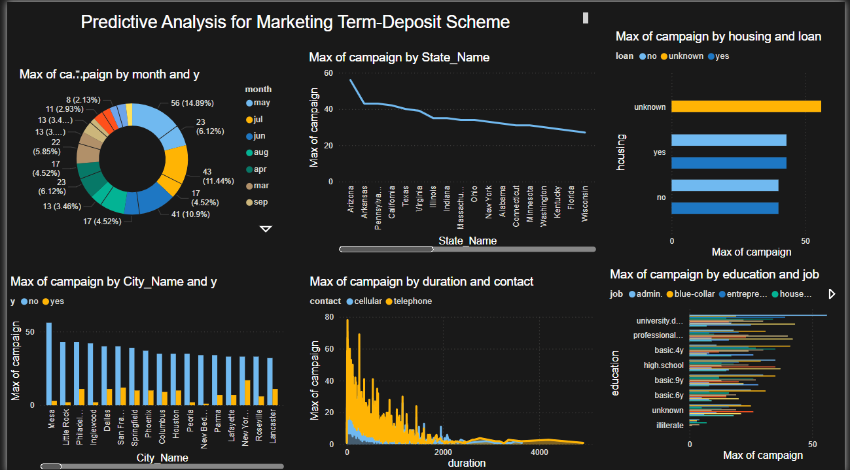
Power BI Visualization (Dashboard)
Notes:
Additionally, you can see from this chart the % split of popularity between the top 5 categories. There is not much difference between each of them, food only outperforms culture by 0.4% within the top 5.
However the difference between the 4th most popular, cooking, and the 5th most popular, animals, is much larger at 1.3%
This tells me that the categories sorted by popularity is weighted towards categories at the top. This means that it exhibits a "greedy" effect, the most popular categories get more popular whilst as you drop down the popularity rankings, you may see that they fall away drastically.

Slide 13
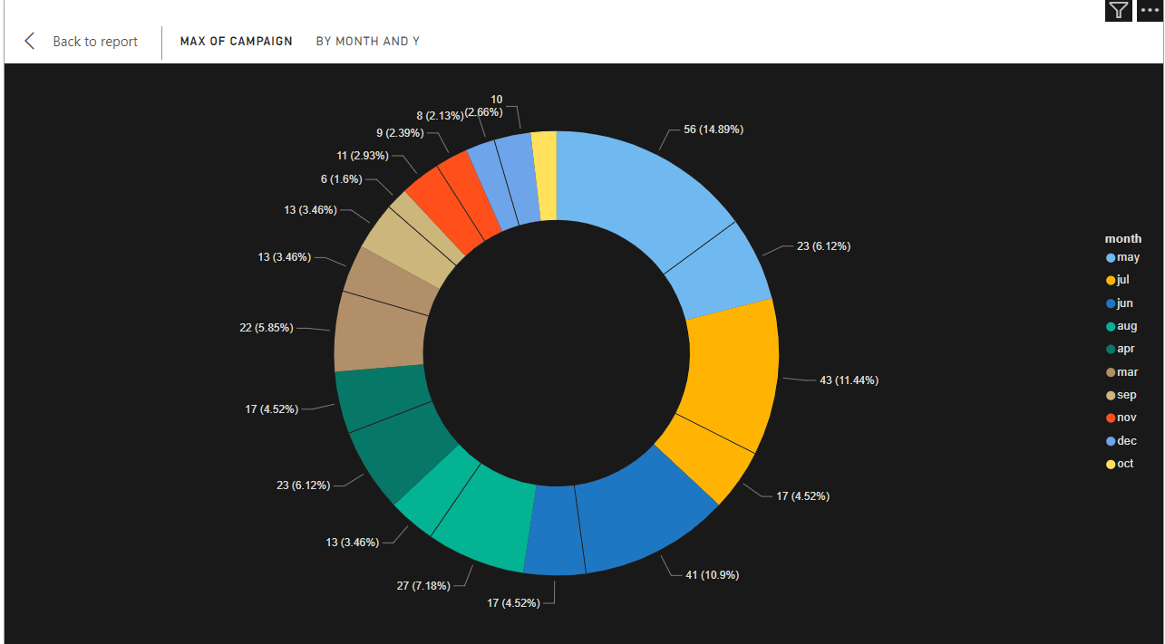
Power BI Visualization
CAMPAIGN RESULT BASED ON MONTH
Notes:
Additionally, you can see from this chart the % split of popularity between the top 5 categories. There is not much difference between each of them, food only outperforms culture by 0.4% within the top 5.
However the difference between the 4th most popular, cooking, and the 5th most popular, animals, is much larger at 1.3%
This tells me that the categories sorted by popularity is weighted towards categories at the top. This means that it exhibits a "greedy" effect, the most popular categories get more popular whilst as you drop down the popularity rankings, you may see that they fall away drastically.

Slide 14
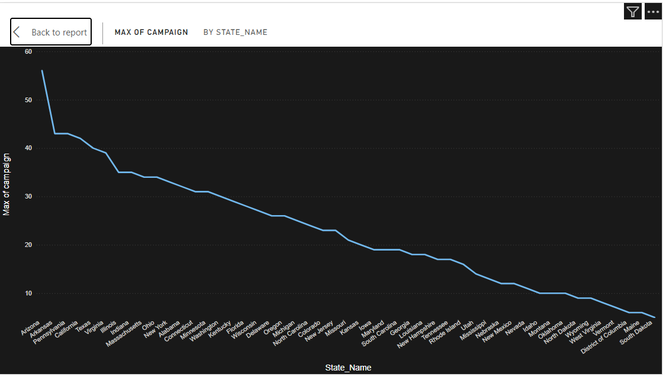
Power BI Visualization
CAMPAIGN RESULT BASED ON STATE
Notes:
Additionally, you can see from this chart the % split of popularity between the top 5 categories. There is not much difference between each of them, food only outperforms culture by 0.4% within the top 5.
However the difference between the 4th most popular, cooking, and the 5th most popular, animals, is much larger at 1.3%
This tells me that the categories sorted by popularity is weighted towards categories at the top. This means that it exhibits a "greedy" effect, the most popular categories get more popular whilst as you drop down the popularity rankings, you may see that they fall away drastically.

Slide 15
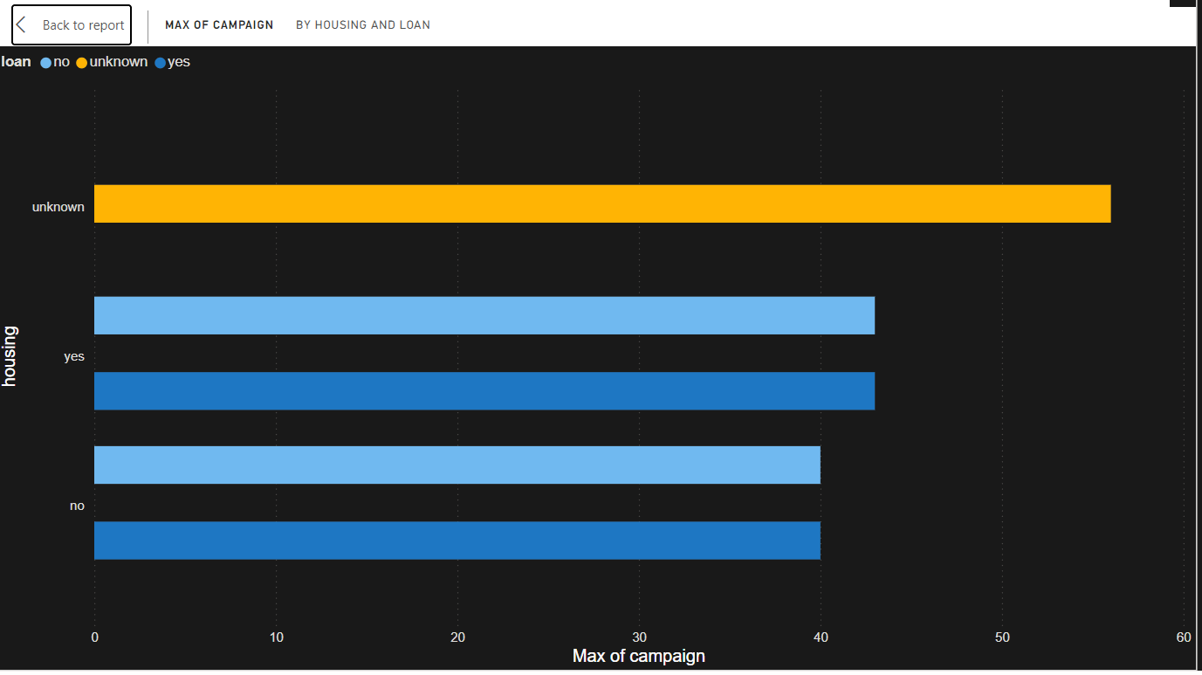
Power BI Visualization
CAMPAIGN RESULT BASED ON HOUSING AND LOAN
Notes:
Additionally, you can see from this chart the % split of popularity between the top 5 categories. There is not much difference between each of them, food only outperforms culture by 0.4% within the top 5.
However the difference between the 4th most popular, cooking, and the 5th most popular, animals, is much larger at 1.3%
This tells me that the categories sorted by popularity is weighted towards categories at the top. This means that it exhibits a "greedy" effect, the most popular categories get more popular whilst as you drop down the popularity rankings, you may see that they fall away drastically.

Slide 16
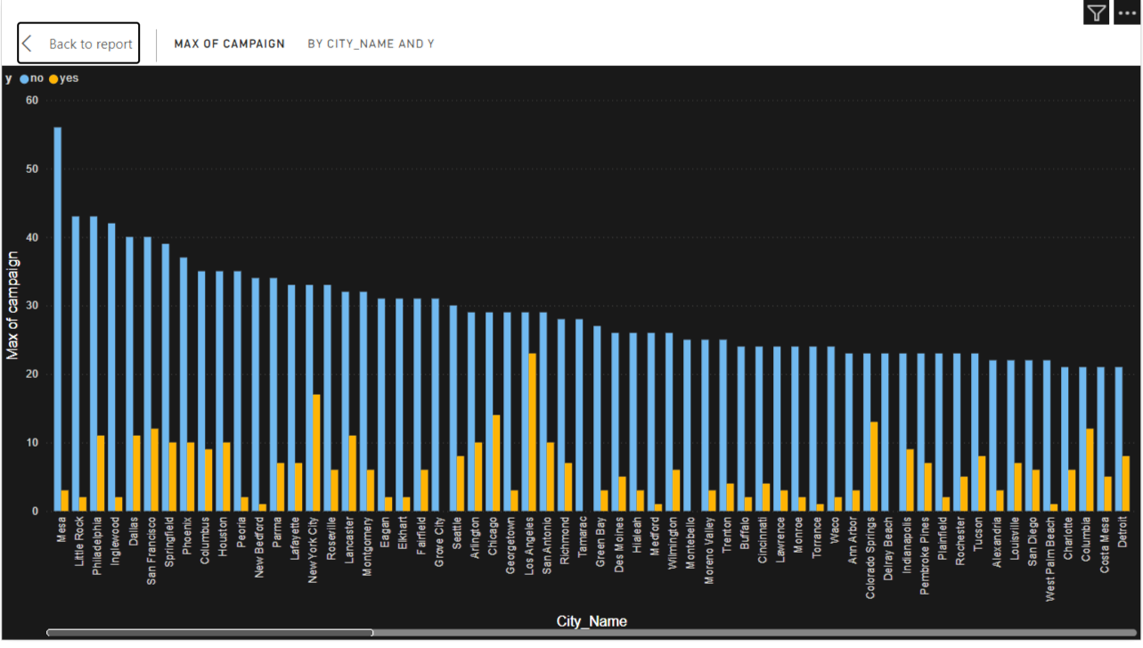
Power BI Visualization
CAMPAIGN RESULT BASED ON CITIES
Notes:
Additionally, you can see from this chart the % split of popularity between the top 5 categories. There is not much difference between each of them, food only outperforms culture by 0.4% within the top 5.
However the difference between the 4th most popular, cooking, and the 5th most popular, animals, is much larger at 1.3%
This tells me that the categories sorted by popularity is weighted towards categories at the top. This means that it exhibits a "greedy" effect, the most popular categories get more popular whilst as you drop down the popularity rankings, you may see that they fall away drastically.

Slide 17
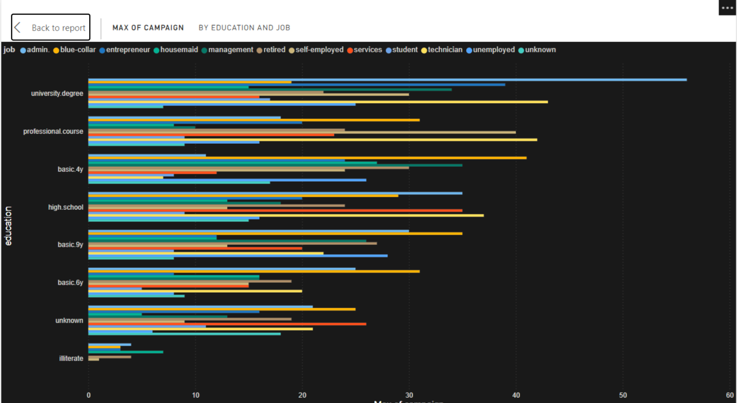
Power BI Visualization
CAMPAIGN RESULTS BY EDUCATION AND JOBS
Notes:
Additionally, you can see from this chart the % split of popularity between the top 5 categories. There is not much difference between each of them, food only outperforms culture by 0.4% within the top 5.
However the difference between the 4th most popular, cooking, and the 5th most popular, animals, is much larger at 1.3%
This tells me that the categories sorted by popularity is weighted towards categories at the top. This means that it exhibits a "greedy" effect, the most popular categories get more popular whilst as you drop down the popularity rankings, you may see that they fall away drastically.

Slide 18
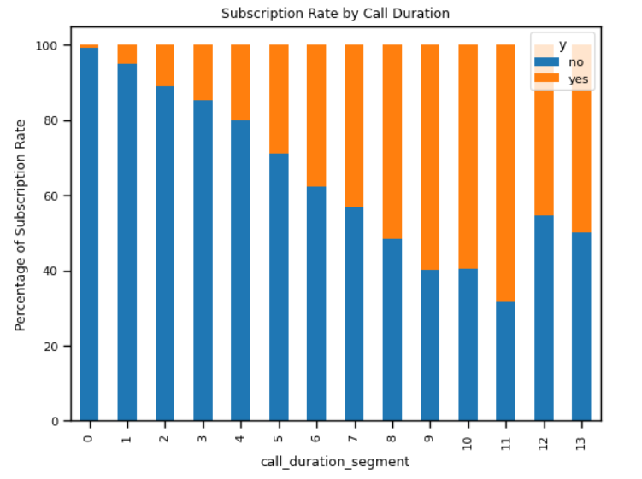
Visualization
CAMPAIGN RESULT BASED ON DURATION AND CONTACT
Notes:
Additionally, you can see from this chart the % split of popularity between the top 5 categories. There is not much difference between each of them, food only outperforms culture by 0.4% within the top 5.
However the difference between the 4th most popular, cooking, and the 5th most popular, animals, is much larger at 1.3%
This tells me that the categories sorted by popularity is weighted towards categories at the top. This means that it exhibits a "greedy" effect, the most popular categories get more popular whilst as you drop down the popularity rankings, you may see that they fall away drastically.

Slide 19
Model Building
Tasks:
Build machine learning model using logistic regression Algorithm.
Train models on the dataset and evaluate performance using metrics like accuracy, precision, and ROC-AUC.
Steps:
Split dataset into training and testing sets in the ratio 80 : 20.
Notes:
From our analysis you can see that the top 5 most popular categories of posts were food, culture, soccer, cooking and animals in descending order.
Food had an aggregate popularity score of almost 1100. It is very interesting to see both food and cooking within the top 5, it really shows what people enjoy consuming as content. But also interesting to see culture too. Clearly users favor "real-life" content on this platform.
Furthermore soccer is an interesting category because there is the European championships being played very soon. This presents a huge opportunity for you to differentiate your platform and to run specific content or events linked to this global spectacle.

Slide 20
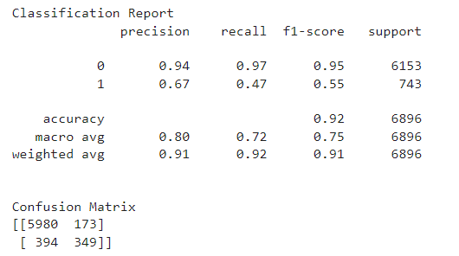
Model Building
CLASSIFICATION REPORT AND CONFUSION MATRIX
Notes:
Additionally, you can see from this chart the % split of popularity between the top 5 categories. There is not much difference between each of them, food only outperforms culture by 0.4% within the top 5.
However the difference between the 4th most popular, cooking, and the 5th most popular, animals, is much larger at 1.3%
This tells me that the categories sorted by popularity is weighted towards categories at the top. This means that it exhibits a "greedy" effect, the most popular categories get more popular whilst as you drop down the popularity rankings, you may see that they fall away drastically.

Slide 21
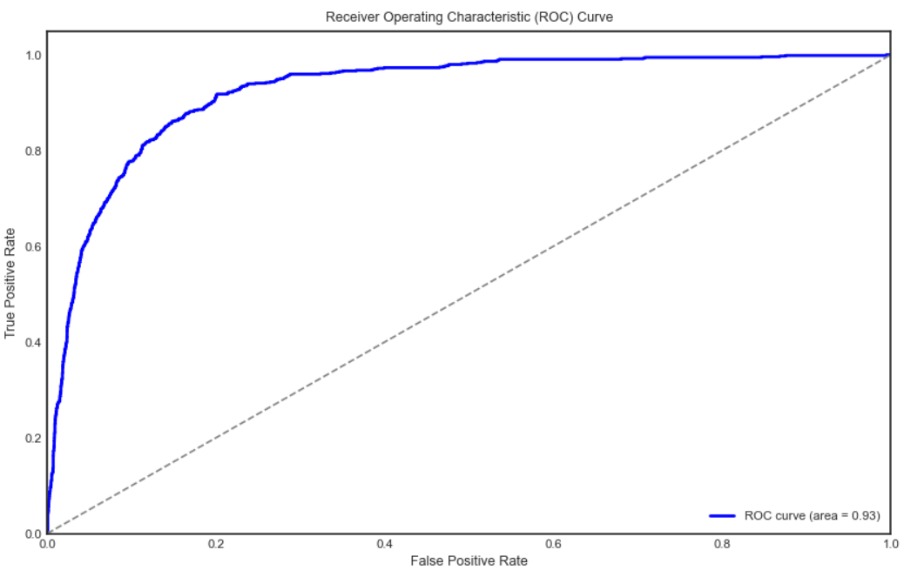
Model Building
ROC CURVE
Notes:
Additionally, you can see from this chart the % split of popularity between the top 5 categories. There is not much difference between each of them, food only outperforms culture by 0.4% within the top 5.
However the difference between the 4th most popular, cooking, and the 5th most popular, animals, is much larger at 1.3%
This tells me that the categories sorted by popularity is weighted towards categories at the top. This means that it exhibits a "greedy" effect, the most popular categories get more popular whilst as you drop down the popularity rankings, you may see that they fall away drastically.

Slide 22
Notes:
Additionally, you can see from this chart the % split of popularity between the top 5 categories. There is not much difference between each of them, food only outperforms culture by 0.4% within the top 5.
However the difference between the 4th most popular, cooking, and the 5th most popular, animals, is much larger at 1.3%
This tells me that the categories sorted by popularity is weighted towards categories at the top. This means that it exhibits a "greedy" effect, the most popular categories get more popular whilst as you drop down the popularity rankings, you may see that they fall away drastically.

Slide 23
Final Presentation
Notes:
From our analysis you can see that the top 5 most popular categories of posts were food, culture, soccer, cooking and animals in descending order.
Food had an aggregate popularity score of almost 1100. It is very interesting to see both food and cooking within the top 5, it really shows what people enjoy consuming as content. But also interesting to see culture too. Clearly users favor "real-life" content on this platform.
Furthermore soccer is an interesting category because there is the European championships being played very soon. This presents a huge opportunity for you to differentiate your platform and to run specific content or events linked to this global spectacle.

Slide 24
Notes:
Additionally, you can see from this chart the % split of popularity between the top 5 categories. There is not much difference between each of them, food only outperforms culture by 0.4% within the top 5.
However the difference between the 4th most popular, cooking, and the 5th most popular, animals, is much larger at 1.3%
This tells me that the categories sorted by popularity is weighted towards categories at the top. This means that it exhibits a "greedy" effect, the most popular categories get more popular whilst as you drop down the popularity rankings, you may see that they fall away drastically.

Slide 25
Notes:
Additionally, you can see from this chart the % split of popularity between the top 5 categories. There is not much difference between each of them, food only outperforms culture by 0.4% within the top 5.
However the difference between the 4th most popular, cooking, and the 5th most popular, animals, is much larger at 1.3%
This tells me that the categories sorted by popularity is weighted towards categories at the top. This means that it exhibits a "greedy" effect, the most popular categories get more popular whilst as you drop down the popularity rankings, you may see that they fall away drastically.

Slide 26
Notes:
Additionally, you can see from this chart the % split of popularity between the top 5 categories. There is not much difference between each of them, food only outperforms culture by 0.4% within the top 5.
However the difference between the 4th most popular, cooking, and the 5th most popular, animals, is much larger at 1.3%
This tells me that the categories sorted by popularity is weighted towards categories at the top. This means that it exhibits a "greedy" effect, the most popular categories get more popular whilst as you drop down the popularity rankings, you may see that they fall away drastically.

Slide 27
Notes:
Additionally, you can see from this chart the % split of popularity between the top 5 categories. There is not much difference between each of them, food only outperforms culture by 0.4% within the top 5.
However the difference between the 4th most popular, cooking, and the 5th most popular, animals, is much larger at 1.3%
This tells me that the categories sorted by popularity is weighted towards categories at the top. This means that it exhibits a "greedy" effect, the most popular categories get more popular whilst as you drop down the popularity rankings, you may see that they fall away drastically.

Slide 28


ANALYSIS
Science and Technology are the most popular categories of content showing that people enjoy “real-life” and “factual” content the most.
INSIGHT
Food is a common theme with the top 5 Categories with “Science” ranking the highest. This may give an indication to the audience within your user base. You could use the insight to create a campaign and work with healthy eating brands to boots user engagement.
Summary
NEXT STEPS
This ad-hoc analysis is insightful, but it’s time to take this analysis into large scale production for real-time understanding of your business. We can show you how to do this.
Notes:
So to summarize:
We tackled this task and found the top 5 most popular categories as asked, but we also went one step further.
- We found that food and culture are the two most popular categories, suggesting that users like "real-life" content
- We also found that soccer was the third most popular, perhaps due to the tournament coming up. This presents a massive opportunity for Social Buzz to ride on this global event, as all eyes will be on it as well as the players.
- As much as this analysis was insightful, we are ready to take it to the next stage and we have the expertise within Accenture to help you realize these kinds of insights in production across your organization and in real time. We would love to help you with this.

Slide 29
Thank you!
ANY QUESTIONS?
Notes:
Thank you very much for listening, please feel free to ask any questions that you may have!

